Slide 1
Eat to Thrive Week 7
March 12, 2026
Nearly all disease can be traced to a nutritional deficiency - Dr. Linus Pauling,
2x Nobel Prize Winner

Slide 2
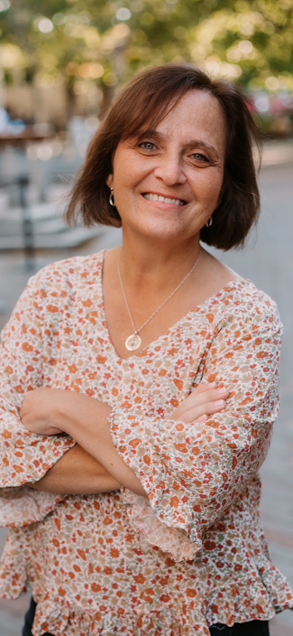
Guided Meditation by Lena Winston
Lena Winston is a licensed Occupational Therapist, adoring mom of 3, grandmother of 2 (almost 3) and lives just north of Boston. She has been blessed to share herself with others who are on a self care journey in life, using nutrition, alternative health, and meditation daily. The Heart of the Meditation and the resiliency tools continue to serve her daily to reduce stress, stay connected to Spirit, trust her inner guidance, heal her emotional body, and strengthen her relationships. Lena has had Stage 4 lung cancer for 10 years, and attributes this meditation practice and eating a raw vegan diet as the means to her health, healing, and vitality.

Slide 3
Homework Assignment
HW: Read Chapter 8, “Holistic Medicine”
Watch DVDs Living Matrix & Ancient and Current Self-Help Techniques
Talk to Your Buddy
Journal

Slide 4
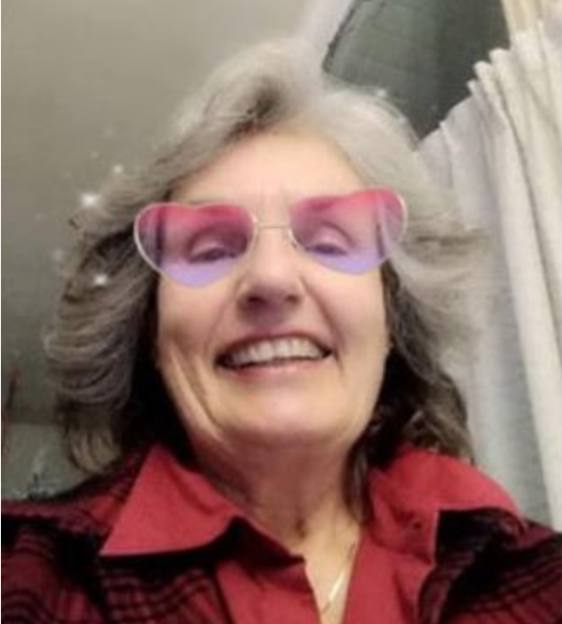
Linda Handrahan
My journey back to balanced health began in my teens when I wanted and needed to lose weight. Fasting was considered unhealthy back then, which I did on and off every few weeks for a few years, not realizing at the time that I was cleansing my body and giving my systems a vacation. In 2014, the Hippocrates 3-week transformation program gave me a new eye-opening journey of cleansing and a new understanding of helping and nourishing my body and soul. Two of the most powerful healing methods at Hippocrates, besides pure love, were sprouts and wheatgrass, both miracle life plants.
Soon after Hippocrates, I found myself teaching children the lifestyle as a teacher in Real Kids Real Food, teaching them not just health but creativity in food.
One of my dreams to date is to create a platform to teach an extension of myself as a painter, furniture designer, and filmmaker, and create visually on different plates as canvases by painting and sculpting with food, using each plate as a piece of art.

Slide 5
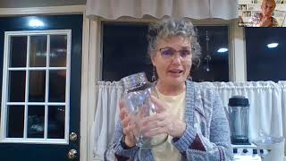
Fermentation Presented by Linda Handrahan

Slide 6
Veggie-kraut pp 308-309 in Eat to Thrive
Ingredients:
One or more of the following vegetables) • cabbage, green, red or savoy (curly) • carrots • daikon • any other vegetable
For leaf layer: • 3-4 whole cabbage leaves peeled from the outside of the cabbage
For the brine: • 2 quarts filtered or spring water • 3 T pure salt, kosher, pickling or coarse sea salt, with no additives Equipment:
Instructions
1. Large pot for boiling water
2. Two wide-mouth quart canning jars
3. Two canning lids and rings
4. 2-4 rocks that easily fit through the mouth of the canning jar.
5. Small pot for sterilizing the canning lids, rings and rocks
6. Wooden pressing tool
7. Wide mouth funnel (optional) for filling the jar
Notes:
Keep in chat

Slide 7
Using Meditation Tools to Build Your Resiliency - Lena Winston
Meditation has proven to be an effective means, and can be the key, to finding more peace, freedom, and health by learning strategies which limit the negative impact of stress, anxiety, and past or recurrent issues.
This presentation will include seven meditation tools where participants will be able to apply those tools in the session.
At the end of the presentation, participants will be guided to make an action plan that will help them strengthen their resiliency. We will provide The Heart of the Matter Resiliency Tool Kit as an additional resource.

Slide 8
Golden Nugget
What part of Lena’s Meditation will you incorporate into your health plan, and how do you think it will impact your well being?

Slide 9
Share your successes and challenges that you have had this week.

