Slide 1
Internal Awareness
Notes:
1

Slide 2
The Digestive System
Prepares food for use by all body cells.
The chemical breakdown of complex biological molecules into their component parts.
  Lipids to fatty acids
  Proteins to individual amino acids
  Carbohydrates into simple sugars
  Digestive enzymes are special proteins that help break up large molecules of food into very tiny molecules that can be absorbed and used by the cells in the form of nutrition.
Notes:
2

Slide 3
Function
Produces various chemicals to break down the food.
Filters out harmful substances.
Gets rid of solid wastes.
Notes:
3

Slide 4
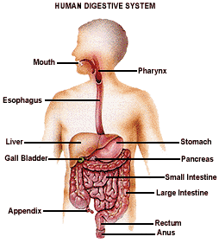
Path of Digestion
Mouth
Pharynx
Esophagus
Stomach
Small Intestine
Large Intestine
Anus
Notes:
4

Slide 5
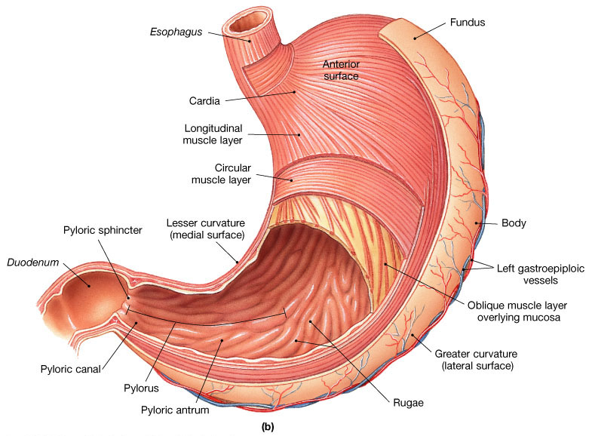
Stomach
Notes:
5

Slide 6
Stomach
J-shaped muscular sac
Churns and grinds together the bolus into smaller pieces.
Food is mixed with gastric juices (hydrochloric acid and enzymes) secreted by the stomach walls.
HCL helps break down food and kills bacteria that came along with the food.
Notes:
6

Slide 7
Stomach
Pepsin – major enzyme; converts proteins into peptides in the presence of HCL.
Mucus – lubricates food and protects the gastric lining from strong digestive juices.
Converts the bolus into a liquid (chyme) after 4 hrs of mechanical and chemical digestion
Chyme passes through the pyloric sphincter into the small intestine.
Notes:
7

Slide 8
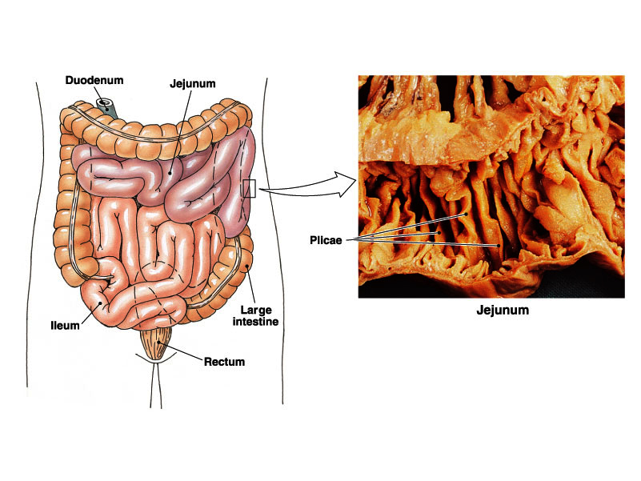
Small Intestine
Site of greatest amount of digestion and absorption
Notes:
8

Slide 9
Small Intestine
Long (20 ft), coiled tube beneath the stomach.
Has three parts:
    Duodenum
    – upper part; about 10 in; connected to the stomach.
    – where the digestive juices from the pancreas and the liver combine with chyme making it thin and watery.
    Jejunum – about 8 ft
    Ileum – about 12 ft
Notes:
9

Slide 10
Small Intestine
Takes about 4 – 8 hrs to complete its journey.
Mucosa (inner wall) – secretes several enzymes that acts on the food.
Where the pancreatic enzymes are emptied into.
Digested nutrients are absorbed through intestinal walls.
Absorbed materials cross the mucosa into the blood then other parts of the body for storage or further chemical change.
Notes:
10

Slide 11
Small Intestine
Has folded inner walls covered with fingerlike projections (villi)
Each villus has tinier projections called microvilli that absorbs digested food.
Villi and microvilli increases the surface area of the small intestine for greater absorption.
Peristalsis moves the undigested food to the large intestine.
Notes:
11

Slide 12
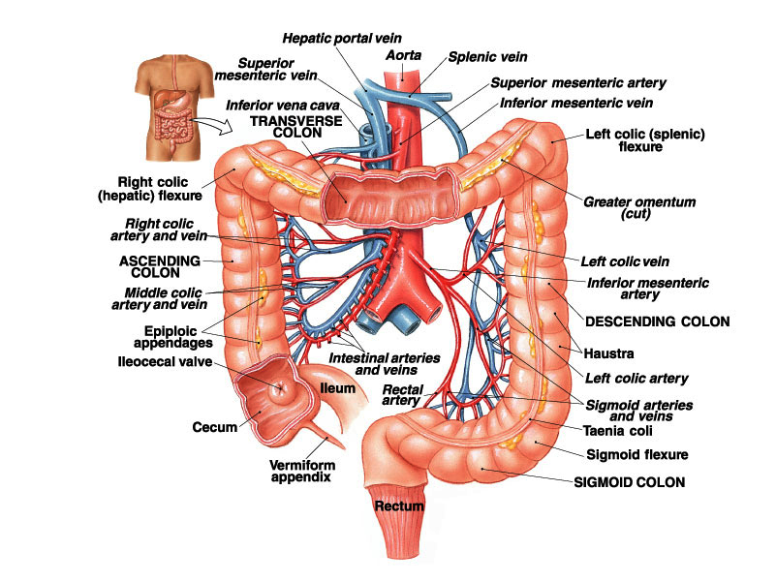
Large Intestine
Notes:
12

Slide 13
Large Intestine
a.k.a. Colon
larger diameter, but shorter (5 ft)
Water is absorbed from the undigested food making the waste harder until it becomes solid.
Waste stays for 10 – 12 hours.
Waste is pushed into the expanded portion (rectum) of the large intestine.
Solid waste stays in the rectum until it is excreted through the anus as feces.
Appendix hangs on the right side of the large intestine.
Notes:
13

Slide 14
Accessory Parts
Organs that are not in the digestive tract but aid digestion
Produce or store enzymes that helps in digestion.
  Teeth
  Tongue
  Salivary glands
  Liver
  Gall bladder
  Pancreas
Notes:
14

Slide 15
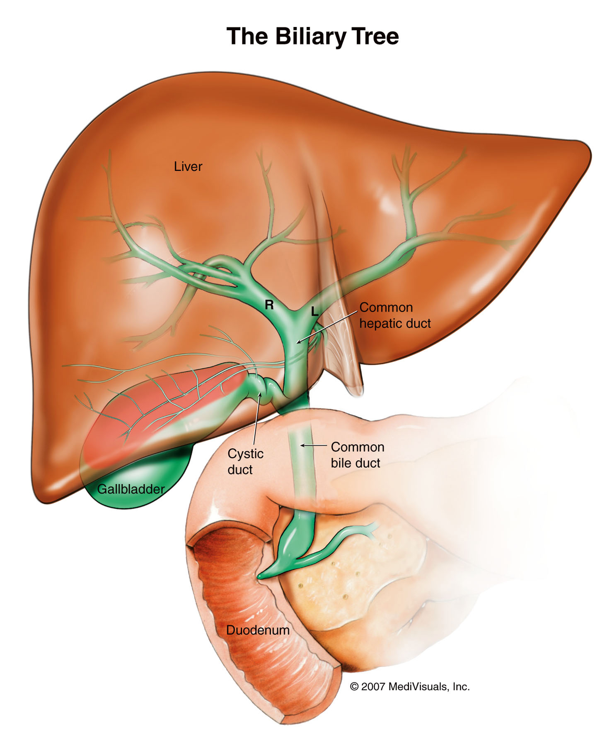
Accessory Organs
Liver
  Largest gland of the body
  Stores vitamins A,D,E,K
  Stores sugar and glycogen
  Produces bile (watery, greenish substance)
  Secretes bile to the gall bladder via the hepatic duct and cystic duct.
Notes:
15

Slide 16
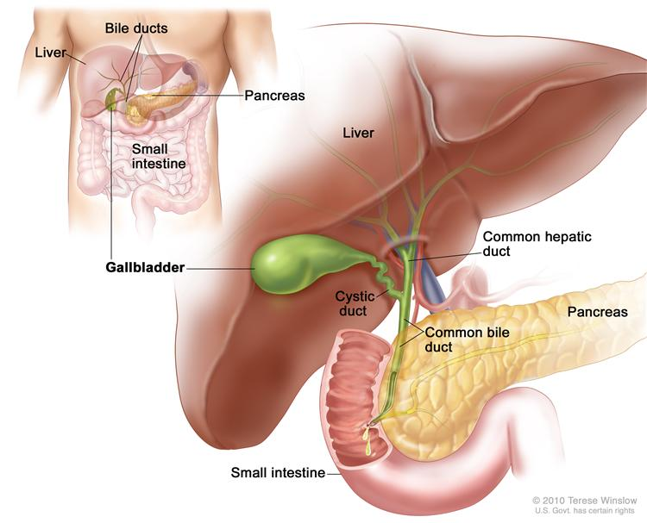
Accessory Organs
Gall bladder
  Stores bile in between meals
  Secretes bile to the duodenum through the bile duct during mealtime.
    Bile contains bile salts, pigments, cholesterol and phospholipids.
    Bile is an emulsifier NOT an enzyme.
    Emulsifier – dissolves fat into the watery contents of the intestine.
Notes:
16

Slide 17
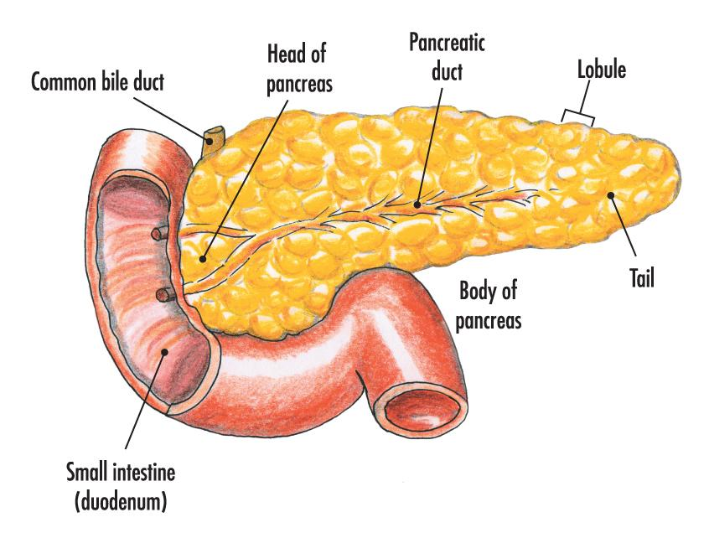
Accessory Organs
Pancreas
  Produces a juice that contains enzymes (amylase and insulin) to break down carbohydrates, fats and protein.
  Secretes the juice into the duodenum through the pancreatic duct.
Notes:
17

Slide 18
Two Types of Wastes
The Excretory System
Gets rid of wastes and other substances that the body doesn’t need.
Solid Waste – from the Digestive System in the form of feces.
Metabolic Wastes – produced by chemical reactions like respiration, hydrolysis, synthesis and neutralization.
  Water
  Carbon Dioxide
  Salts
  Urea
Notes:
18

Slide 19
Organs of Excretion
Skin
  Allows water, salt and urea to diffuse from the blood (capillaries) into the sweat glands.
  Releases sweat from the sweat glands through the sweat ducts out to the skin pores.
Lungs
  Excretes the waste product of respiration during exhalation.
  Carbon Dioxide and Water Vapor.
Notes:
19

Slide 20
Organs of Excretion
Liver
  Part of the digestive, circulatory and excretory systems.
  Removes excess amino acids from the body.
  Breaks down the amino acids through deamination to form the urea which is excreted in the urine.
Kidneys
  Major excretory organs of the body which removes most of the body wastes.
  Purify blood by filtering out water, salts, digested food particles and urea in the form of urine.
  Urine passes out through the urinary tract.
Notes:
20

Slide 21
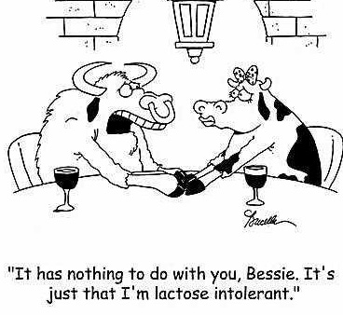

Slide 22
What conditions within the gut masquerade as systemic diseases like Lupus and Rheumatoid Arthritis?
22

Slide 23
        Inflammatory conditions,
        Auto-immune conditions,
        Mood and behavior disturbances,
        Obesity,
        Food allergies
23

Slide 24
Digestive Enzymes
Since flatulence and bloating are usually caused by poor digestion of a certain food or a meal, digestive enzymes can offer relief as they help to break down the problem-causing foods.
Enzymes should be taken before meals for the best results.
Common digestive enzymes include:
24

Slide 25
Enzymes involved in the break down of carbohydrates
(starches and sugars):
Amylase
Glucoamylase
Alpha-galactosidase
Invertase
Diastase
Lactase
Enzymes involved in the breakdown of fats:
Bile
Lipase
25

Slide 26
Enzymes involves in the breakdown of proteins:
Trypsin
Protease
Pepsin
Peptidases
Bromelain
Papain
Betaine HCL
Enzymes for the breakdown of plant fibres:
Cellulase
Pectinase
Read more: http://flowingfree.org/how-to-get-rid-of-gas-and-bloating-now-and-forever/#ixzz2i6FlN9C7
26

Slide 27
Bitter Herbs
Bitter herbs stimulate the the secretion of hydrochloric acid and digestive enzymes, thus improving overall digestion which results in a decreased occurrence of intestinal gas and bloating.
Herbal bitters can be taken as needed or you can take them on a more long term basis to tonify the digestive organs.
Bitters should be tried before taking digestive enzymes, as it is preferable to get the body to produce it’s own enzymes, rather than supplement with enzymes.
27

Slide 28
Aloe vera
Angelica
Artichoke
Barberry
Blessed Thistle
Boldo
Boneset
Bogbean
Centaury
Chamomile
Chiretta
Colombo
Dandelion
Bitter herbs include:
Gentian
Goldenseal
Gold Thread
Horehound
Mugwort
Quassia
Wormwood
Virginia Snakeroot
Yarrow
28

Slide 29
Some bitters are quite strong and may not be well tolerated in people with a weaker constitution.
Bitter herbs should not be used continuously over a long period. If you are using them long-term be sure to cycle them by taking one week off for every 3 weeks you take the herbs.
Herbs can be taken individually, but for best results a bitters formula is recommended.
Common herbal bitters formulas include “Angostura Bitters” and “Swedish Bitters”.
29

Slide 30
Enemas
Read more: http://flowingfree.org/everything-you-ever-wanted-to-know-about-giving-yourself-an-enema-and-were-afraid-to-ask/#ixzz2i6CGhArG
Notes:
30

Slide 31
People may administer an enema for a variety of reasons such as:
  relief from constipation, gas and bloating
  colon cleansing
  reducing toxic load in the body
  elimination of intestinal parasites
  reduction of candida overgrowth
  improving overall health and well being
First you will need an enema bag or canister; there are various types available:
31

Slide 32
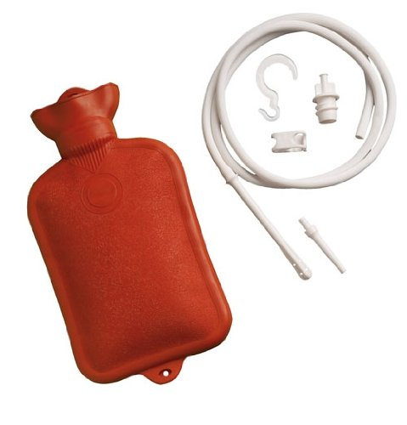
Reusable Enema Bag
  can double as a hot water bottle
  sturdy, durable, and keeps your enema solution from cooling too fast.
  can be difficult to clean. If you are using only water, or salt water, this bag will be fine with only a rinse, but this type of bag is not recommend if you are using other formulas because of the difficulty to clean inside the bag.
  cannot see the fluid level in this bag.
32

Slide 33
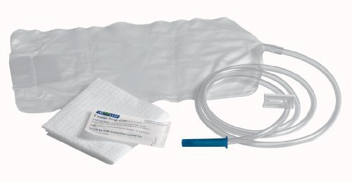
Disposable Enema Bag
can be used multiple times if you rinse it out thoroughly.
have a wider opening at the top, making them easier to refill and to clean than the hot water type bag.
are transparent and often have the fluid level indicators marked on the bag.
33

Slide 34
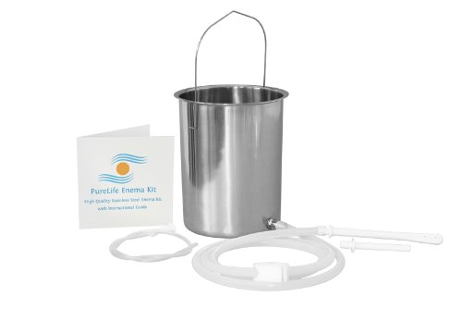
Enema Can
are usually made of stainless steel and will easily last a lifetime.
The tubing may need replacing at some point, but the cans themselves may be the best option if you plan to make enemas a regular part of your life.
are the easiest to clean after use, and the easiest to refill if you are doing a few consecutive enemas.
34

Slide 35
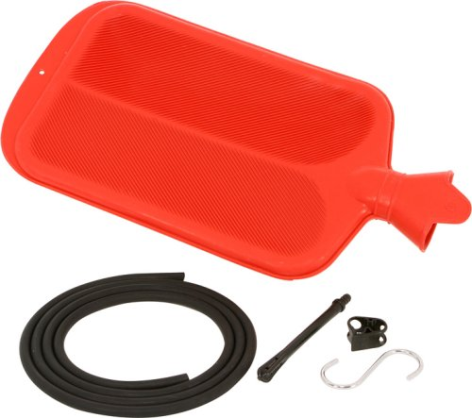
High-Volume Enema Bag
Most enema bags and containers are 1.5- 2L but high volume bags up to 4L
Using a larger bag will eliminate the need to refill the bag if you are administering high-volume enemas.
Although, it is not recommended to administer a high-volume enema on your first try, this may be the bag for you if high-volume enemas are your ultimate goal. This bag holds a lot, but it is still a bag, so consider if the convenience of not having to refill the bag outweighs the extra effort for cleaning the bag.
35

Slide 36
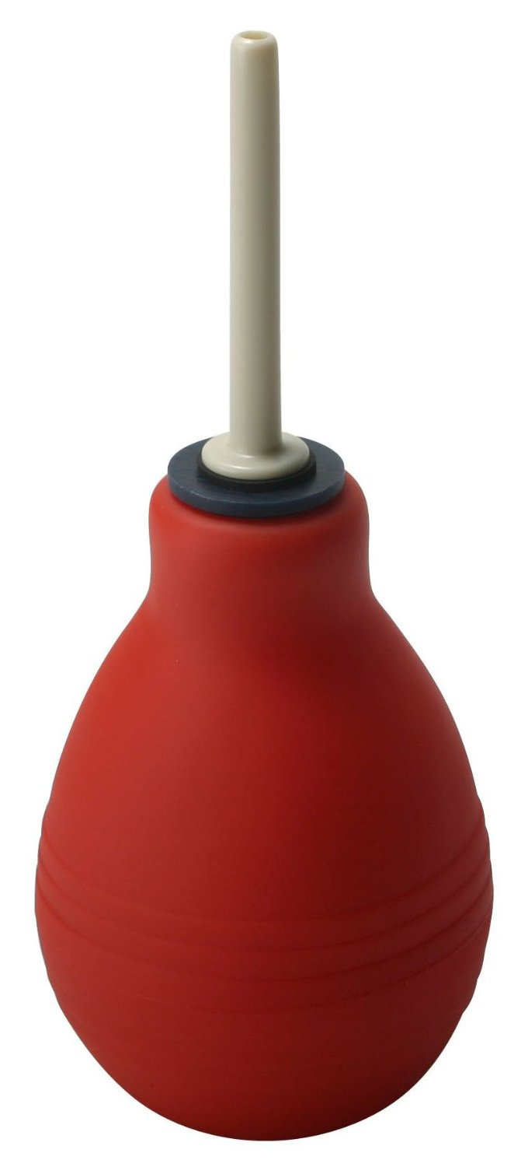
Bulb Syringe
most are under 500ml in volume and are somewhat useless if your goal is to cleanse your colon;
are good for small children and for implants
Another problem with the bulb syringe, is that once it is in your rectum and you have squeezed it, if you release the pressure of your hand, the bulb will inflate, sucking fluid, or matter, back into the bulb. You have to hold a very firm grip on the bulb while the nozzle is in you rectum to avoid drawing anything back into the bulb.
36

Slide 37
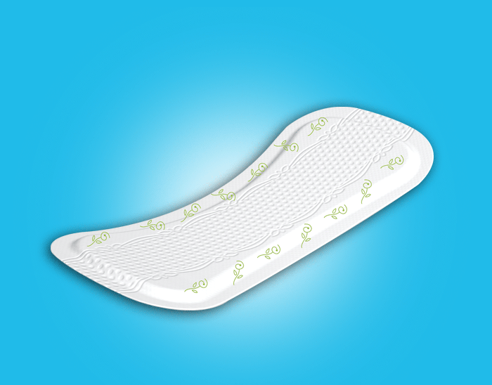
When is the best time to take an enema?
First thing in the morning on an empty stomach.
Plan to stay at home or somewhere you have easy access to a toilet for 1hr after the enema. Make sure you do not have any big plans the day you schedule your enema, as you may feel slightly depleted afterward.
Choose a day when you will not be interrupted. If you live with others, tell them your anticipated washroom schedule.
37

Slide 38
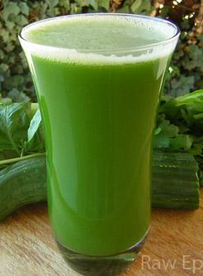
What should you eat the day before an enema?
Fast on juice or fruits only the day before you plan to do your enema. This will make your enema more efficient and decrease the chance of nausea.
If you are unable to do a complete fruit fast the day before, then at least try to ingest only foods which are easily digestible. Stay away from flour products, meat, fish, eggs, cheese, potatoes, bananas, beans and legumes.
Make sure to drink at least 3L of water the day before your enema. Avoid alcohol and carbonated beverages.
38

Slide 39
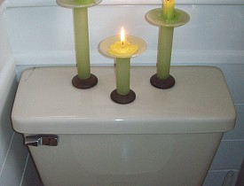
Prepare your Space and Equipment
Having everything in order will make you feel more at ease.
Choose a place to do your enema where you will be close to the toilet. Lay a few old towels on the floor for comfort and for catching any solution that may leak out. The room should be warm, as you will probably want to be naked from the waist down.
You will need a place to hang the enema bag; a door handle or towel bar works well. Alternatively, you can install a hook at the appropriate height.
39

Slide 40
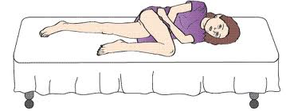
Get Into Position
Once you have everything in place for your enema, it is time for you to get into position. There are 3 common enema positions:
Left-side: This is the best position for taking an enema. Lay down on your left side. Keep the left leg straight and bend the right knee towards the chest, knee resting on the floor. You can rest your head on a pillow or on the left arm. Your right arm will be able to reach your anus easily in this position, making inserting and removing the nozzle quite comfortable.
40

Slide 41
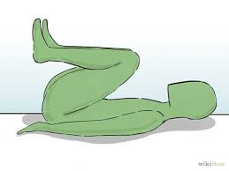
On the back
Another common position. Lay on your back with the knees to the chest. Hands can rest on your knees. You can place a pillow under your head for comfort. It may be more difficult to reach the nozzle in this position.
41

Slide 42
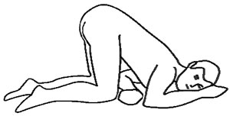
Buttocks up
Get onto your knees and elbows. The head should hang low and your buttocks will stick up in the air.
You can place one or two pillows underneath your chest to make things more comfortable. Also make sure there is enough cushioning under your knees and elbows. This position may be more difficult to relax in and does not provide as easy of reach to the anus as the left-side laying position. The nozzle also tends to slip out more in this position.
42

Slide 43
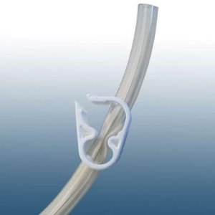
Prepare for Insertion
Remove air bubbles.
Clamp the tube to stop the flow.
Check the position of the clamp, it should be placed a few inches up from the nozzle to ensure an easy reach.
Lubricate with coconut oil or another natural lubricant.
43

Slide 44
Insert and Let It Flow……
The tip of the nozzle should go about 3 inches past your internal anal sphincter.
Un-clamp the tube and relax as the solution flows in.
Keep you hand on the clamp to prevent the nozzle from slipping out and to make it easy to adjust the flow if you find the pressure to be too much. You can also hang the bag lower to reduce the pressure.
44

Slide 45
Remember to relax!
The sensation of water filling and expanding the colon may be unpleasant or uncomfortable, but it will not be painful.
Don’t be in a rush. You want to get as much of the solution in as possible, but if it enters too quickly it could stimulate peristaltic action and make you evacuate too soon.
You may not be able to get all of the solution in on your first try, this is normal. Take in what you can while remaining comfortable. There is no need to tolerate pain or high levels of discomfort; you can always administer another enema once you have evacuated.
45

Slide 46
Remove the Nozzle and Retain the Enema
When you have finished emptying the enema or when you have taken in as much solution that you can comfortably hold, clamp the tube and slowly remove the nozzle from your anus. Lay in comfortable position on the floor.
Slightly clench the anus to ensure the solution does not leak out.
46

Slide 47
How long should you hold it in?
Try hold the enema in for at least 10-15mins. The longer you can retain it, the better the results will be.
if you make it to 10 minutes in any position you’re doing really well! If it is not possible to hold the solution in for more than a few minutes on your first try, don’t fret, your will be able to increase the maximum holding time with continued use.
Assist the movement of water with massage
While you are laying there, massage the abdomen in a counter-clockwise direction to assist the water to flow into the entire colon. Begin in the lower left corner of the abdomen and massage towards the ribcage to move the water up the descending colon. Next, massage across the upper abdomen to moving the water along the transverse colon and then massage down the right side of the abdomen to move the water into the ascending colon and the cecum area.
47

Slide 48
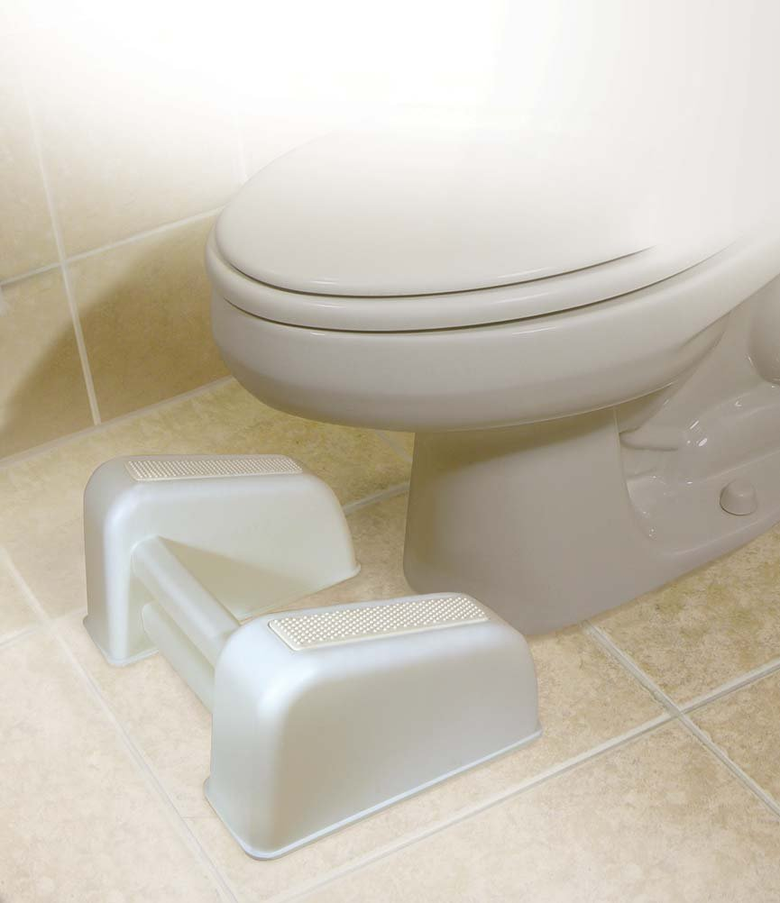
Evacuate the Enema
When your desired holding time has been reached or you feel a strong urge to evacuate, get up and move to the toilet. The entire enema may not come out in the first evacuation, so stay close to a toilet for the next 30-60 minutes.
48

Slide 49
Are enemas safe?
Yes, enemas are very safe and provide wonderful health benefits. Complications are very rare in healthy adults. Use you equipment properly and within reasonable limits and you should have no problems. Read the precautions below to make sure you have no contraindications for enema therapy.
Precautions
enema usage can result in dehydration, be sure to drink a lot of fluids the day you do your enema and replenish your electrolytes if you are using enemas on a regular basis.
49

Slide 50
Do not administer enemas if:
you have undiagnosed abdominal pain
you have tumors or a perforation in the rectum or colon
there has been recent surgery to your colon or rectum
you suffer from acute flare up of Crohn’s disease, colitis, or diverticulitis
you have a history of heart attacks, irregular heartbeat or renal failure
you are less than 7 months pregnant (after 7 months check with your doctor before administering an enema)
you suffer from a severe illness which causes weakness
50

