Slide 1

Revealing the Ancient Wisdom of Keeping Healthy
Jonathan Fang Lic. Ac., MS, MAOM

Slide 2

How do you describe Health?

Slide 3
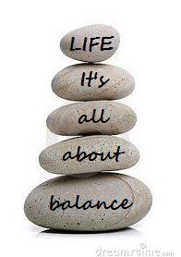
Health is Balance
Mind and Body
Me and Family
Work and Vacation

Slide 4

Ancient Wisdom
Tao Te Ching - Lao Tzu - Chapter 25
Man follows the earth.
Earth follows heaven.
Heaven follows the Tao.
Tao follows what is natural.
(translation by Gia-fu Feng and Jane English)

Slide 5
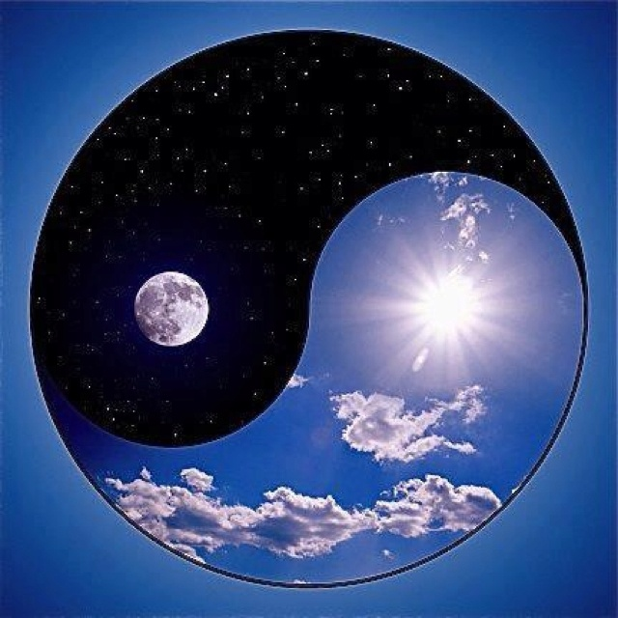
What is nature?

Slide 6
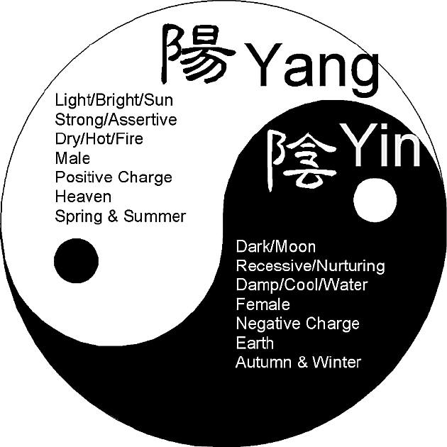
What is nature?
Yin and Yang
Relative
Balance
Transform
Active
Passive

Slide 7

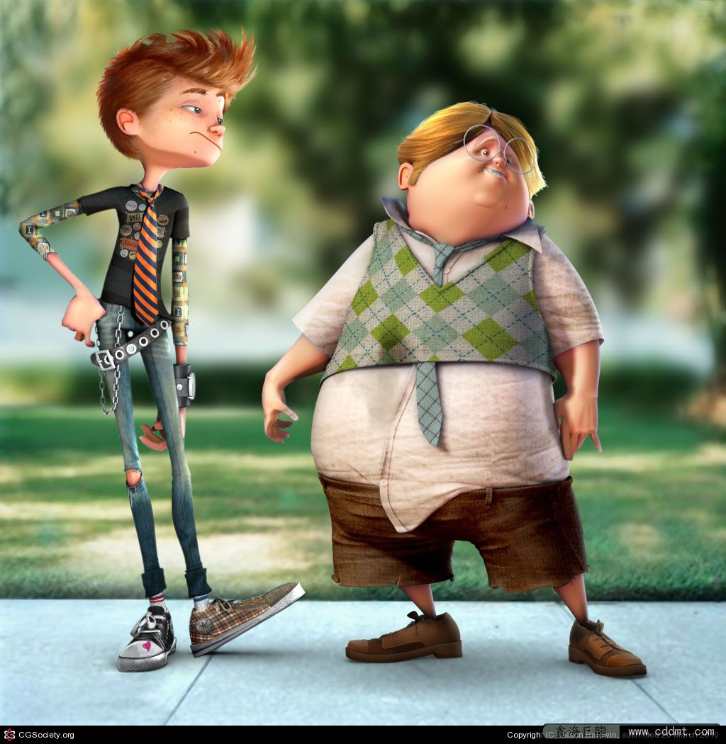
Am I Yin or Yang type?
Body size
Complexion
Voice
Temperature
Odor

Slide 8
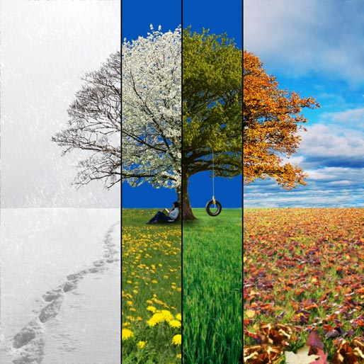
How to balance Yin and Yang?
Seasonal changes

Slide 9
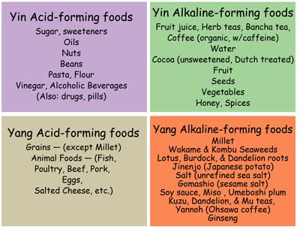
How to balance Yin and Yang?
Seasonal changes
diet

Slide 10
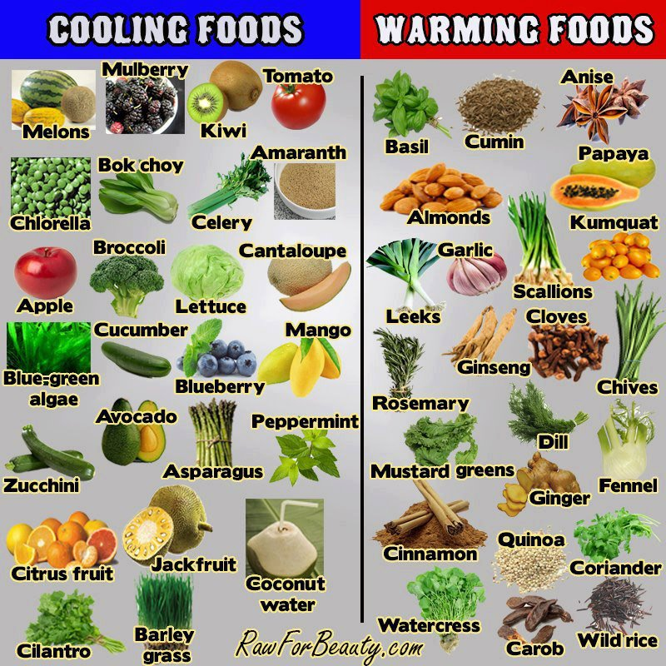
How to balance Yin and Yang?

Slide 11

What do we see in nature?

Slide 12
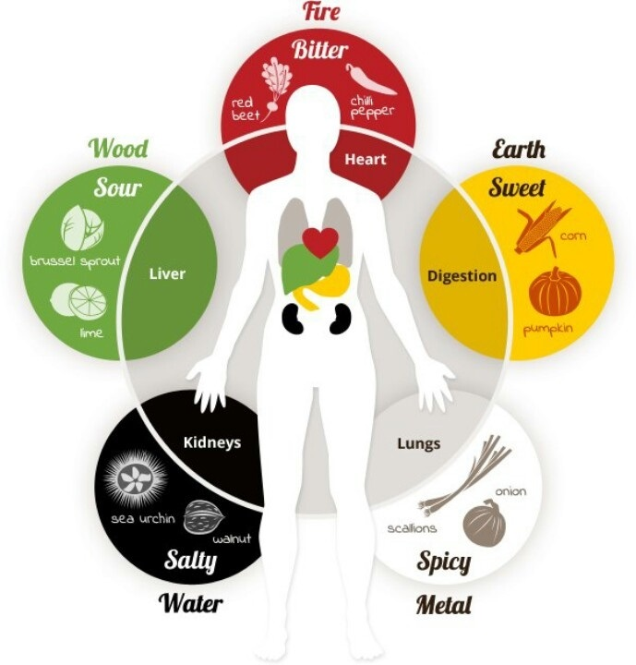
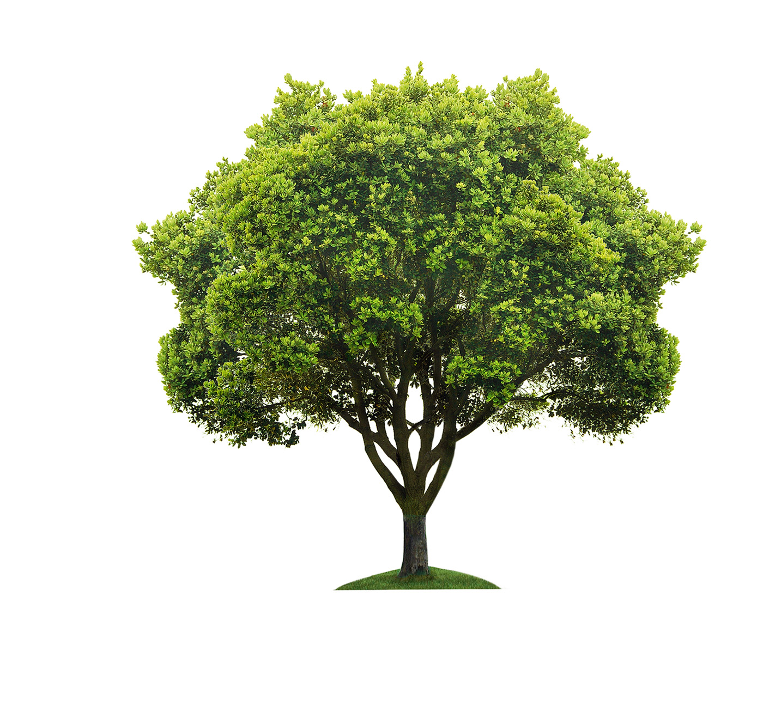
Five Elements
WOOD

Slide 13
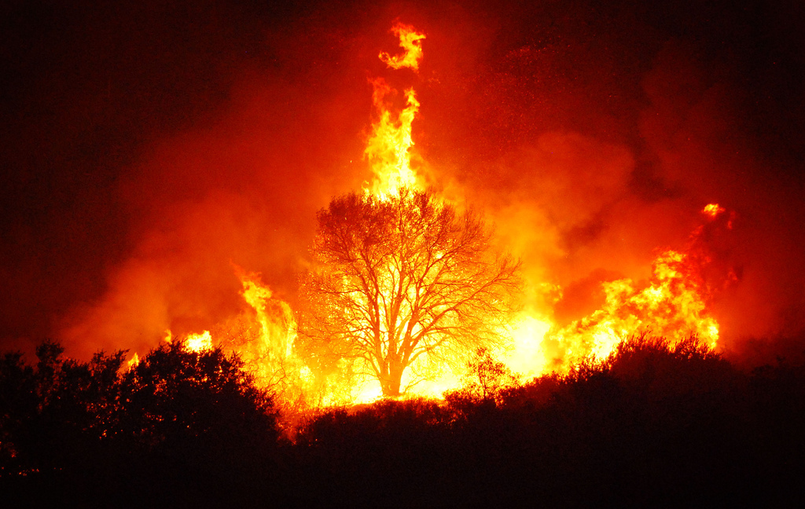
Five Elements
WOOD
FIRE

Slide 14
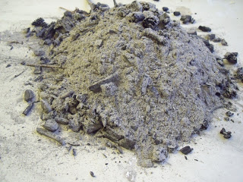
Five Elements
FIRE
EARTH
WOOD

Slide 15
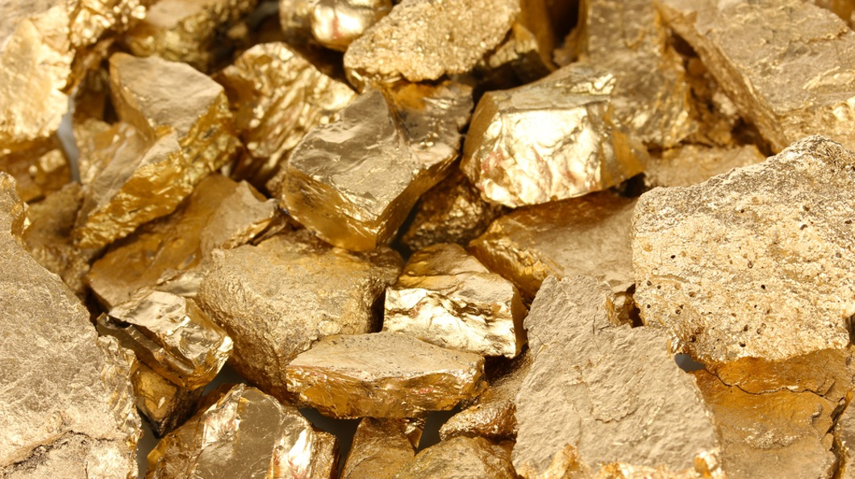
Five Elements
FIRE
WOOD
EARTH
METAL

Slide 16

Five Elements
FIRE
WOOD
EARTH
METAL
WATER

Slide 17
Five Elements
FIRE
Generating cycle
WOOD
EARTH
WATER
METAL

Slide 18
Five Elements
FIRE
WOOD
EARTH
WATER
METAL

Slide 19


Slide 20
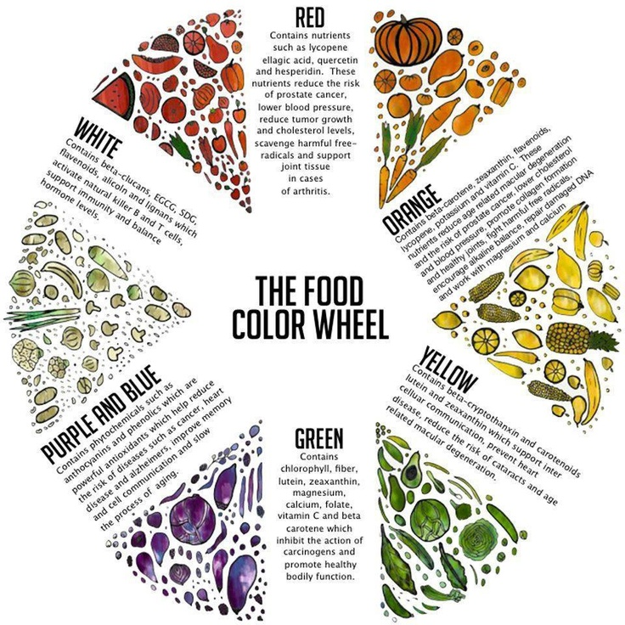

Slide 22
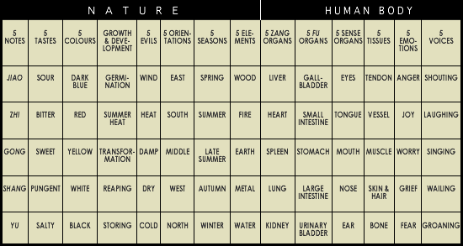
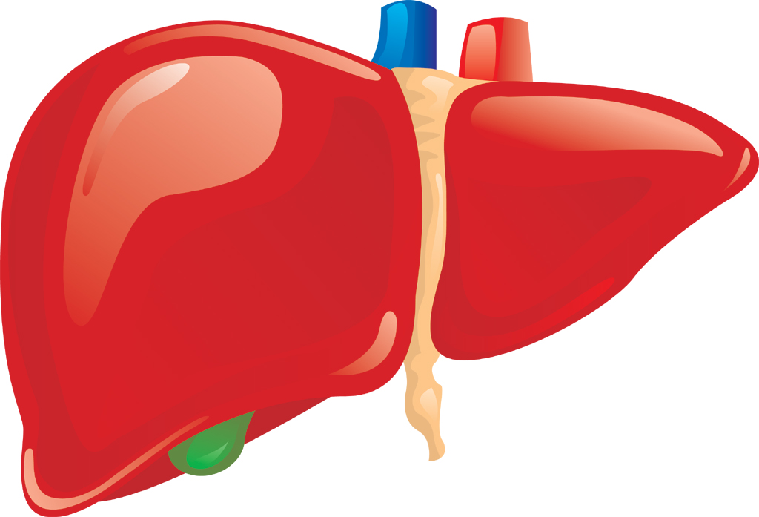

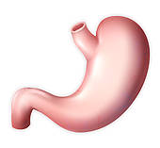
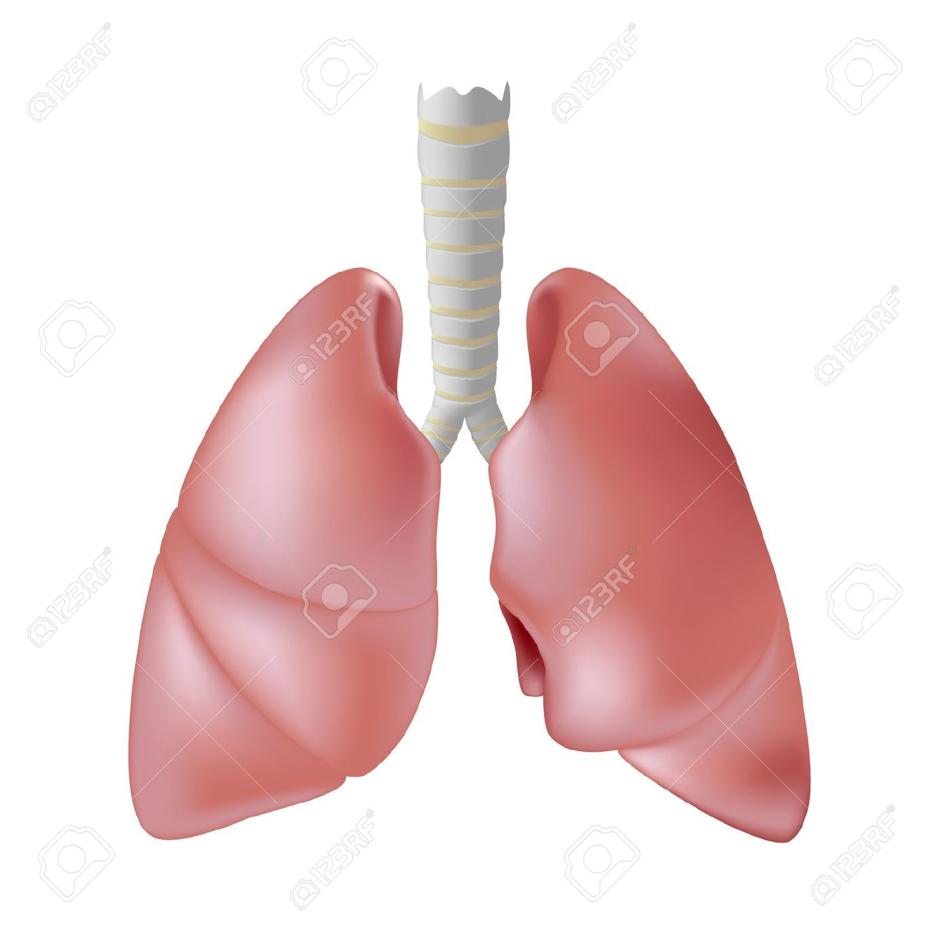
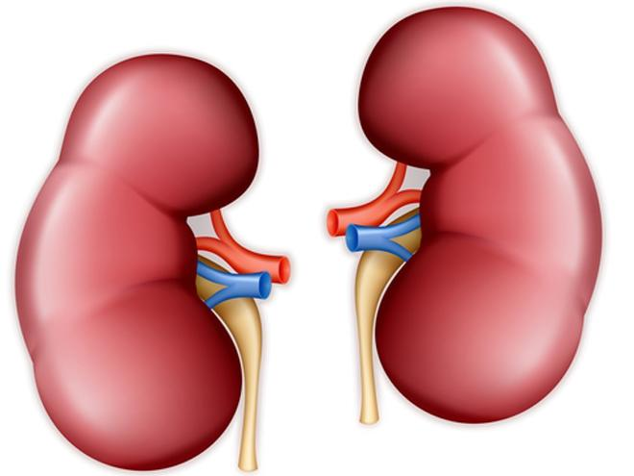
Qi
GREEN
ME
SO
DO
RE
LA

Slide 23
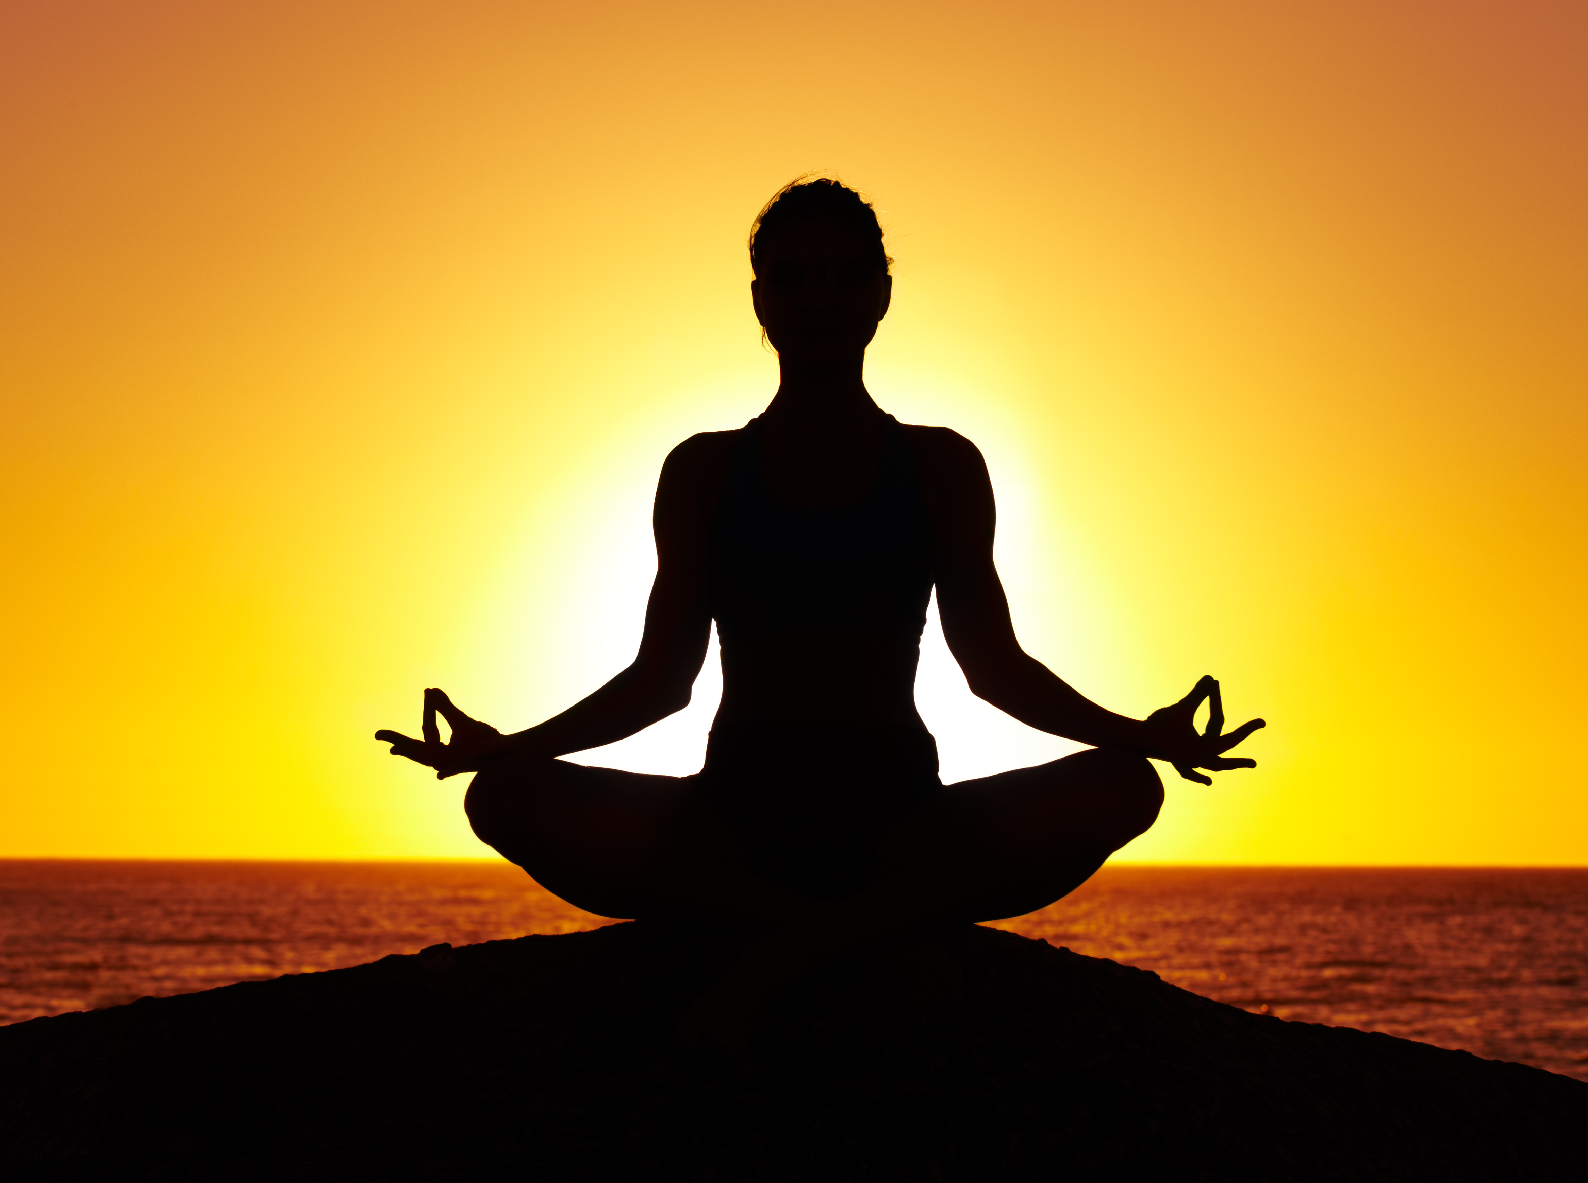
How do we keep healthy

Slide 24
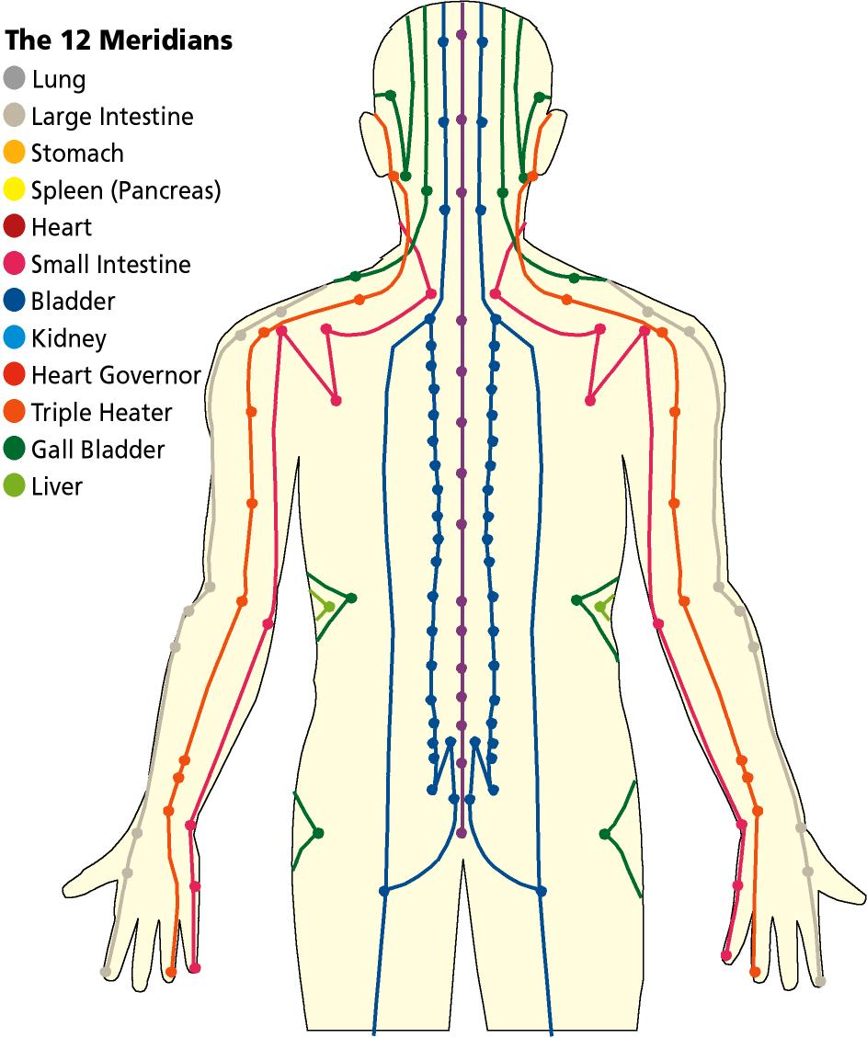

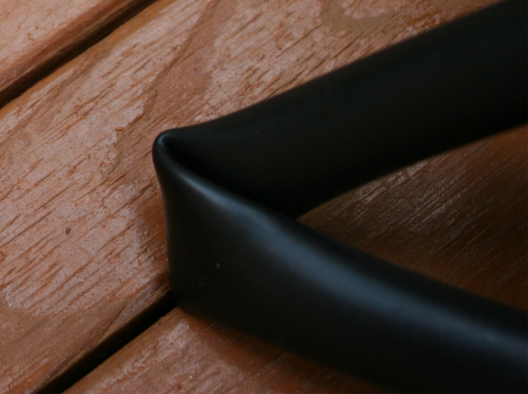
What is keeping you away from healthy

Slide 25
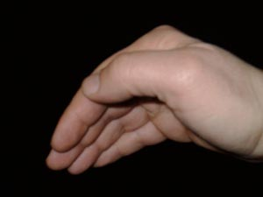
Let’s learn a simple exercise
Tapping Exercise
Soften your wrist & fingers

Slide 26

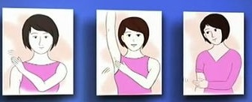
2. Tapping your Head and Shoulder gently

Slide 27
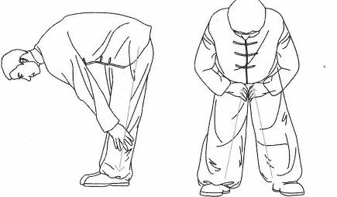
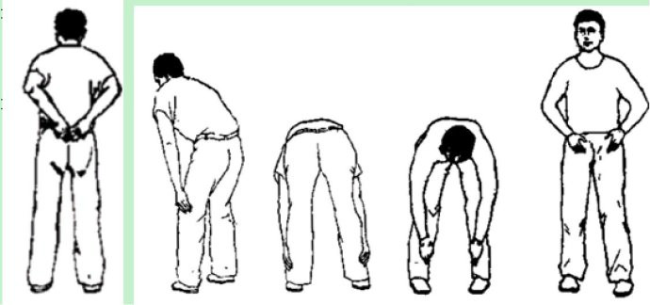
3. tapping legs

Slide 28
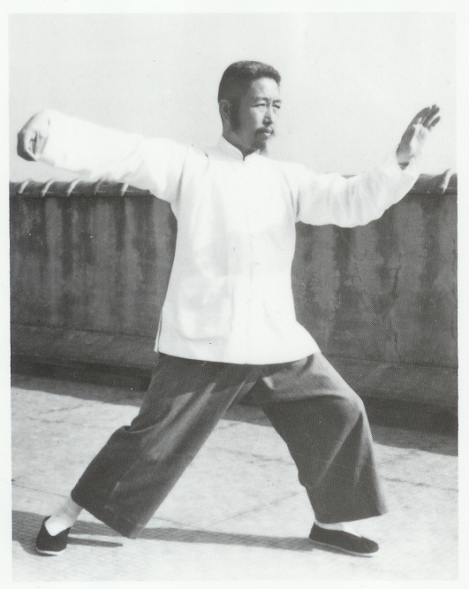



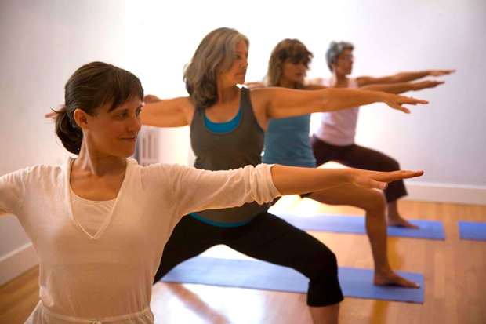

Slide 29
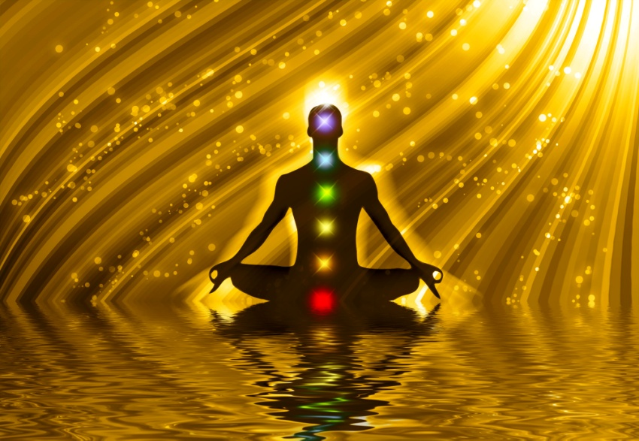
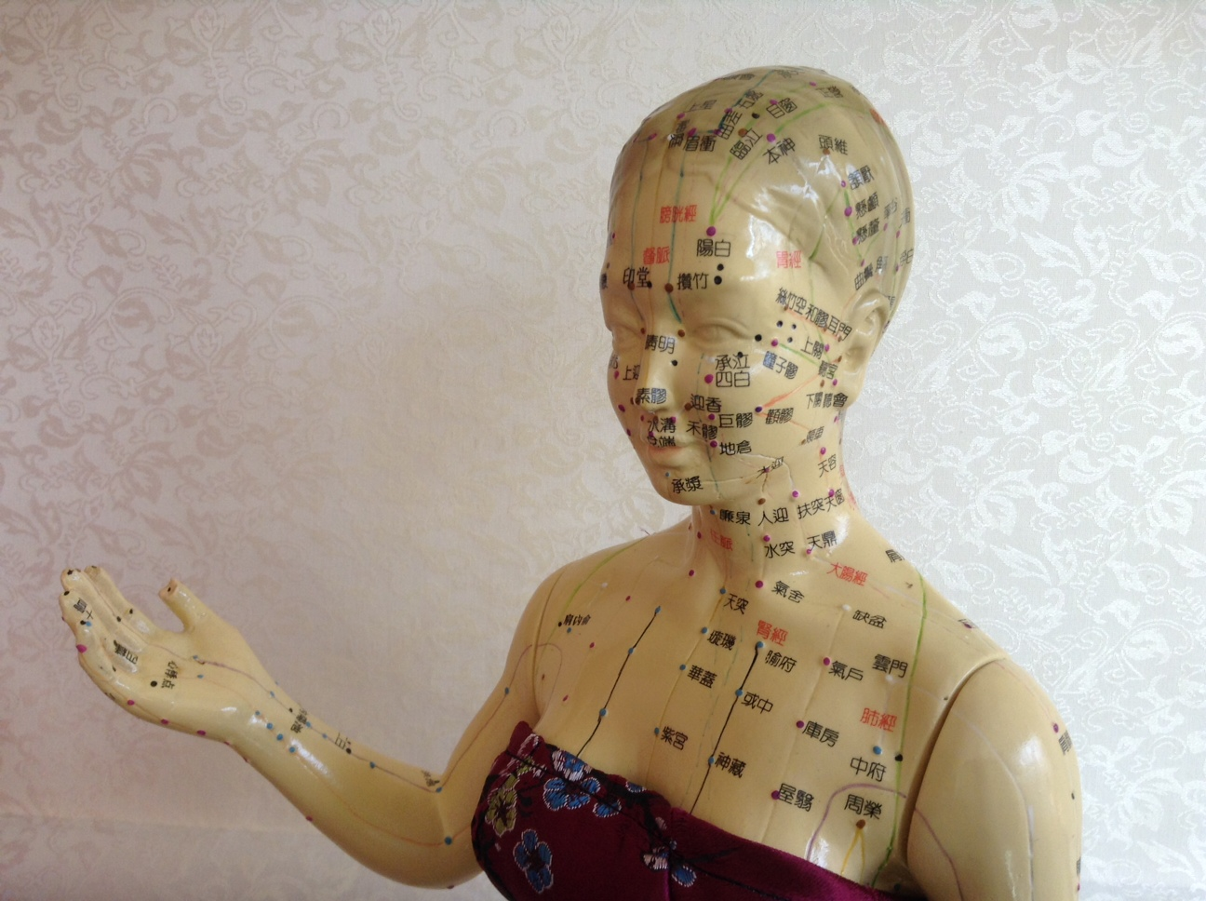
Energy Balance

Slide 30
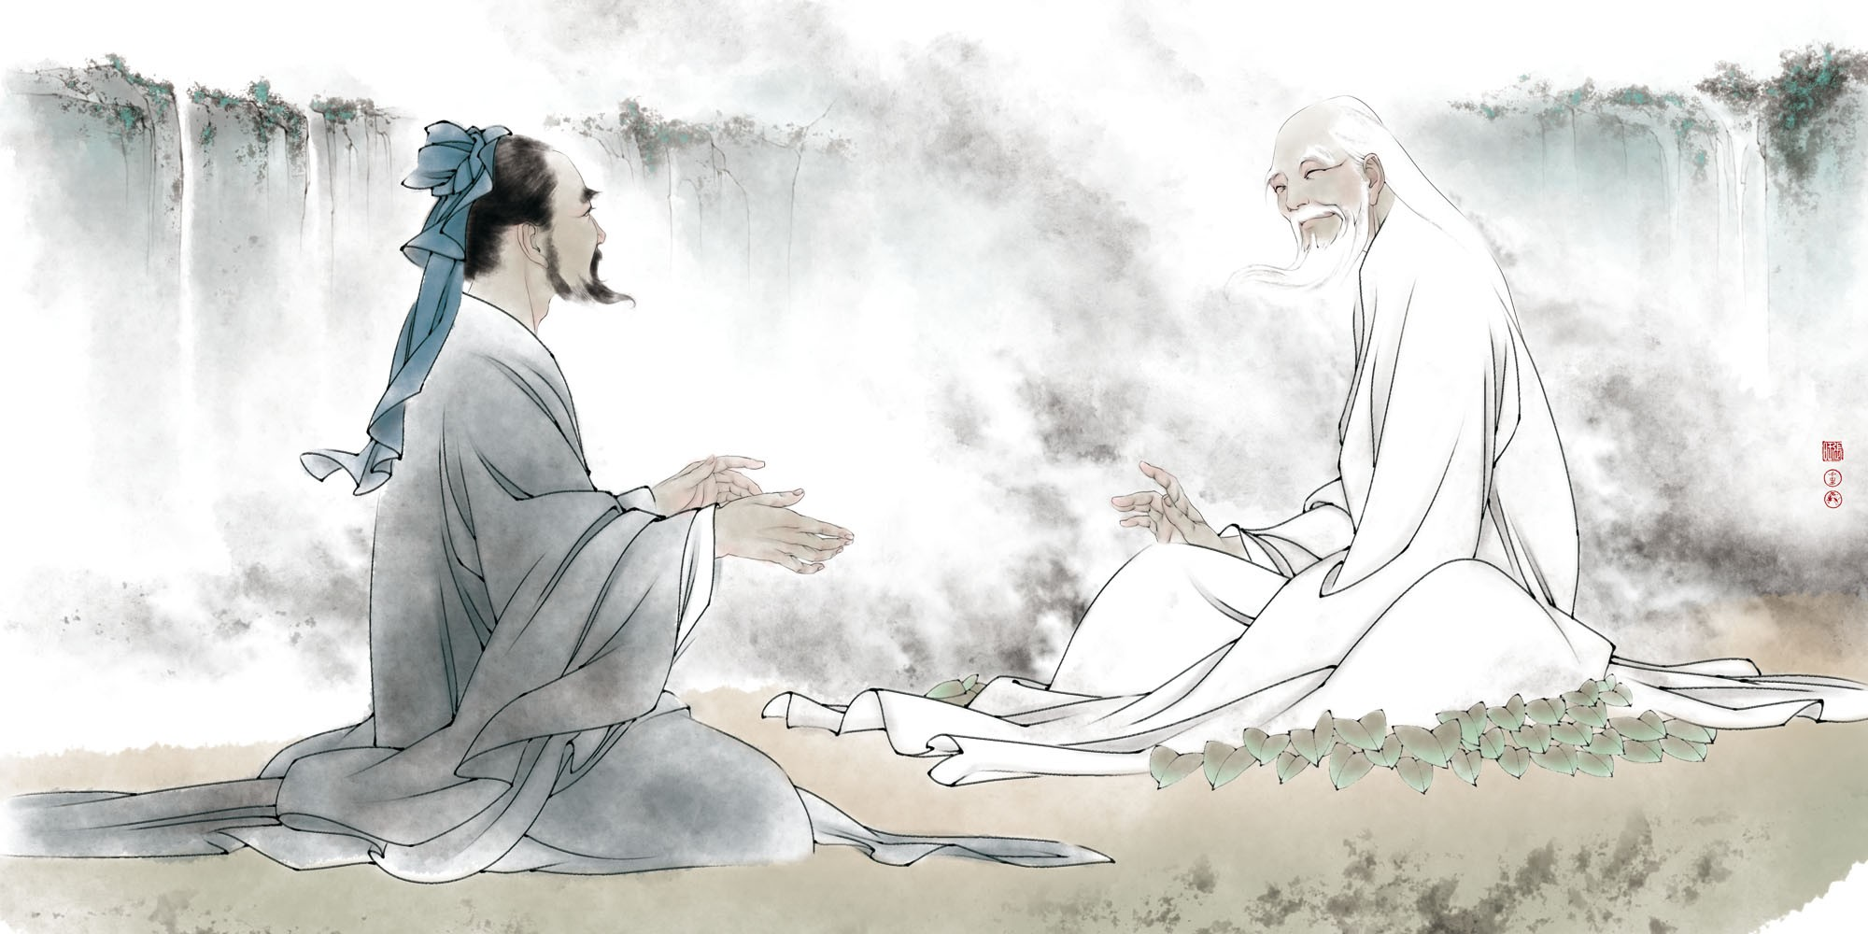
Apply Ancient Wisdom in Life
GIFT

Slide 31
Revealing the Ancient Wisdom of Keeping Healthy
Jonathan Fang Lic. Ac., MS, MAOM

