Slide 1
Week 2
Eat to Thrive - Fall 2021
September 23rd

Slide 2
Guided Meditation led by Cindy MacCulloch
The purpose of Guided Meditation is to achieve mental, emotional, and physical healing and stress relief to transition from the outside world to class. It’s guided to help keep people’s minds from the tendency to wander.

Slide 3
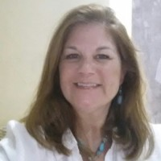
Cindy MacCulloch
I developed an interest in beginning a lifestyle with a healthy diet almost 20 years ago when I started to have some chronic health problems. I was fortunate to learn that food is really the best medicine for becoming healthy and happy inside and out.
I am not completely vegetarian but I strive to continuously add more raw vegetables, wheat grass juice and sprouts to my diet as much as possible. I believe this is truly the best way to live and as Betsy's title suggests, "Eat To Thrive!"
I am on my way to gaining increased energy and vitality to help me to live a full, happy and healthy life which includes reaching my many exciting goals in both my personal and professional life. I took Betsy's program last summer. This is my second class with Betsy which I know helps to keep me back on track.

Slide 4
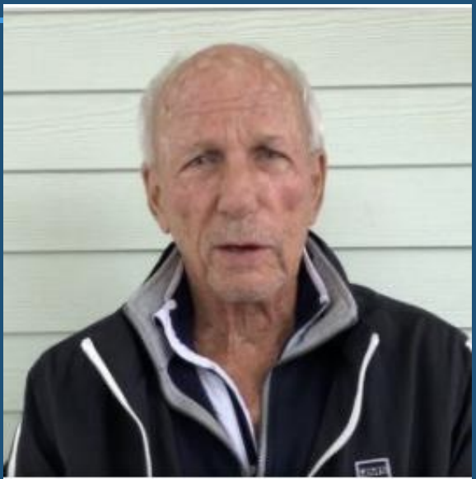
Food Presentation by Clint Norton
I’ve had a total of 11 cardiac events in
my life. I literally was on the cusp of
death. I changed to a plant-based diet
through the Eat to Thrive method and
I’ve seen astounding results. I haven’t
had a heart attack in 5 years and I’m
trying to make sure more people can
live as healthily as I am and I want
them to play golf with me four times a
week.

Slide 5
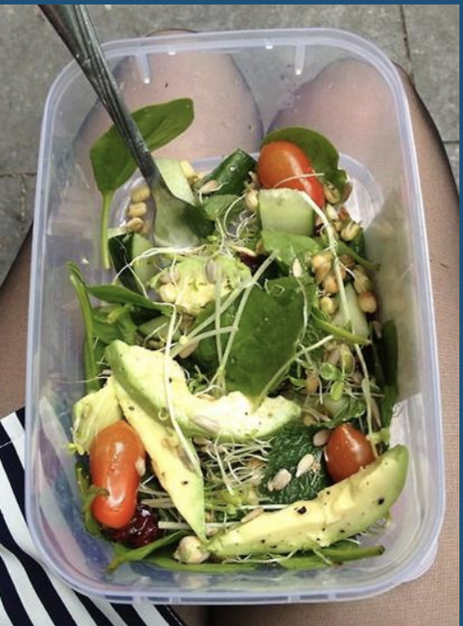
One of Clint’s Daily Meal Plans
Menu:
Breakfast
Clint’s Morning Drink
Hemp Milk
Quinoa Pudding
Lunch - Clint’s Lunch Salad
Supper - Green Goddess

Slide 6
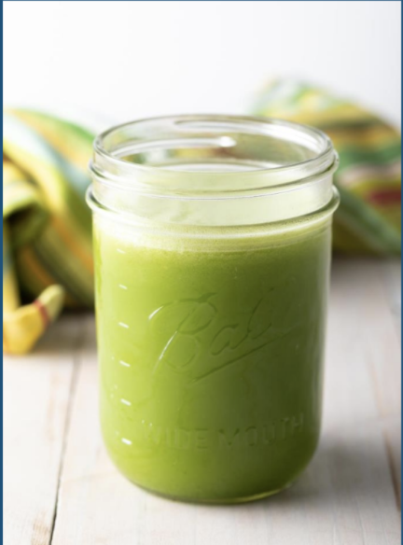
Clint’s Morning Drink
Ingredients:
2 oz wheatgrass juice
3⁄4 regular sized beets for blood pressure
3 stalks of celery
1⁄2 English cucumber
1 apple
3 medium carrots
3 handfuls of sunflower sprouts
1 handful of dandelion greens
Instructions:
juice

Slide 7
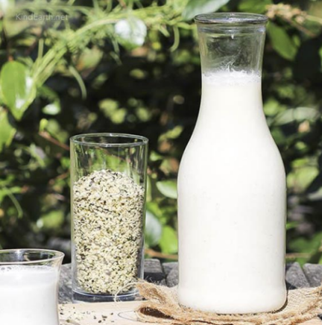
Hemp Milk
Ingredients:
1/2 cup hulled hemp seeds
3-4 cups water (use less water for thicker, creamier milk!)
1/2 tsp vanilla extract (optional)
2 Tbsp cocoa or cacao powder for "chocolate milk" (optional)
1/4 cup 1/4 cup fresh berries for "berry milk" (optional)
Instructions:
Add hemp seeds, water, and any additional add-ins (optional) to a high-speed blender. Top with lid to ensure it doesn't splash. Blend until the mixture seems well combined.
Scoop out a small sample with a spoon to test flavor/sweetness. Add more dates, salt, or vanilla as needed.
Use desired amount. Clint does not recommend storing it for longer than a day.

Slide 8
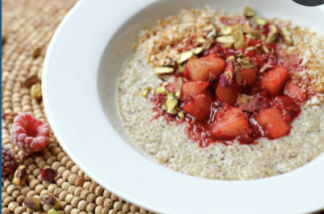
Quinoa Porridge
Ingredients:
1⁄2 cup Ancient Harvest Quinoa Flakes
1 cup of water
1 tsp Maca powder
1 tbsp flax seeds
Instructions:
Grind flax seeds in blender
Add all other ingredients in blender and include hemp milk
Serve in a bowl topped with fruit of your choice

Slide 9
Clint’s Lunch Salad
Ingredients:
1 Avocado
Lettuce
Tomato
Cucumber
Sunflower Sprouts
Black Olives
Cilantro, Squeeze of Lemon Juice (optional)
Instructions:
Chop all ingredients to ¼ inch (except lettuce)
Mix it all up in a bowl
Serve on a bed of lettuce
Enjoy!

Slide 10
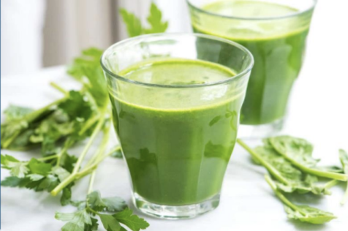
Green Goddess On-the-Go
Ingredients:
1 cup lettuce
1 cup celery
1 cup cucumber
2 inch slice of peeled aloe vera
1⁄2 cup sprouts -- Clint recommends sunflower sprouts
1 avocado
1⁄2 clove garlic
1 slice of onion
Sea salt and pepper to your liking
Handful of spinach, touch of parsley, small handful of dandelion (optional)
Instructions:
Add all ingredients into a blender and use plunger to push it all down
Pour and enjoy!

Slide 11
Assignment
Order sprouting kits from “Perfect Food” (see class materials for link)
Read Chapter 3 “Indoors Sprouting for Fun and Nutrition”
Watch Videos for week 3 in Eat to Thrive Classroom
“Growing Your Own Food” - required (read outline in classroom Week 2)
“Fat, Sick, and Nearly Dead” - optional
“Overcoming the Food Imprint” - optional

Slide 12
Review: Chapter 2, The Living Food Kitchen
What is living food?
Why make a grocery list?
What is organic and why care about it?
Why should you care about pesticides?
Why care about GMOs? Why care about irradiated food?
Why care about canola oil?
Why is it important to drink water?
Why is the kind of water you drink important? (Water Wisdom)
Note: Equipment will be discussed as used.

Slide 13
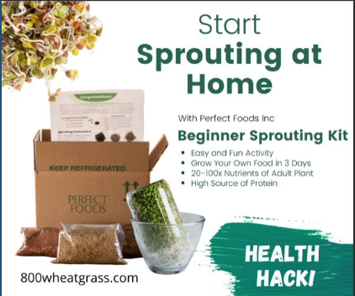
Sprouting Options
Eat to Thrive Custom Kit - $54
Everything you need to sprout enough for a week
Includes:
2 Reusable solid trays
1 Reusable tray with holes for drainage
Potting soil with fertilizer in it
Wheatgrass seed enough for 1 tray
Sunflower seeds enough for 1 tray
Mung bean seeds - 1⁄2 cup
Lentil seeds - 1⁄2 cup
Broccoli seeds - 3 tbsp
Cheesecloth sufficient for sprouting in mason jar or bowl
For Ordering go to Week 2 in the ETT Classroom Materials
You can also pick up these items from Betsy in Waltham for $25 if you help package it
To buy fresh wheatgrass and sprouts, go to www.lifeforcegrowers.com and pick up in Somerville

Slide 14
Speaker: Joanne Schmalenberger
Joanne,, wellness educator, fitness trainer and founder of GravOxy, has been born with Lymphangioma. Thanks to her open-minded approach, education about biology, physiological anatomy, and physics, she was able to overcome her disease. Due to this awareness, she was able to create fitness training protocols that concentrate on cellular development in the body and that emphasize natural body movements.
During our session, she will be teaching:
warm up with movement, patterns, and stretching in motion
strengthening and cardio mix with shakers
calm and stretch with the breath
GravOxy - 17 South Avenue, Natick, MA Work phone: (508) 545-1320 Email: beyondfitboston@aol.com

Slide 15
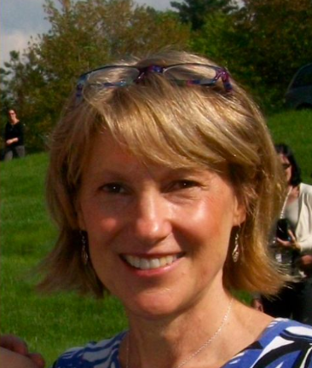
Speaker: Leslie Barnett
Leslie Barnett is an integrative health coach and specializes in helping people rediscover their inner radiance and empowering them to live more fully with peace and confidence. She considers both the biochemistry and the bioenergetics in the healing process. Leslie also is trained and teaches Biofield Tuning, a unique sound healing method that restores the body to a more natural healing state.
In tonight's presentation, Leslie will be discussing pH as a measure of the vital energy in your body, food combining to promote healing and an interesting take on the energetics of food.
https://www.barnettwellnessconsulting.com
Leslie@BarnettWellnessConsulting.com
(508) 314-0587
Sherborn, MA

Slide 16
Keep Sharp - Sanjay Gupta
“The single most important thing to enhance brain function and resiliency to disease is EXERCISE.”
“Getting up for light activity such as walking for two minutes every hour was associated with a 33 percent lower chance of dying over a three year period.” - 2015 study of Univ. School of Medicine.
Exercise effectively uses circulating blood sugar and reduces inflammation while stimulating the release of growth factors, substances that promote both the proliferation and function of cells

Slide 17
Breakout Room Discussion
#1 What are your successes and challenges in achieving your habit?
#2 What have you learned from Leslie’s and Joanne’s presentations that you are interested in applying to your own lives?

Slide 18
Main Room Debriefing
Share a summary of what you discussed in the breakout rooms with the whole class.

Slide 19
Feedback from You
Eat to Thrive is focused on learning and improving and thus, feedback is extremely important. Please share your golden nugget or your takeaway from Clint’s, Leslie’s, and Joanne’s presentation. Here are some questions to stimulate your feedback:
What did you like about the presentation?
Did you find the information useful and if so, how? Did you have any “Aha’s”?
Did this presentation inspire you to incorporate more fresh, live foods into your diet?
What could be improved?
Other comments or suggestions

Slide 20
“If you do what you’ve always done, you get what you’ve always got.”
- Mark Twain

